Slide 1
Case Study 5
Analysis of real estate prices using Zillow, Realtor.com and FRED Data

Slide 2
Previous Assignment (Case Study 4)
How did the Federal Reserve’s monetary tightening from 2021–2026 propagate through consumer auto financing, bank lending standards, and durable-goods manufacturing output?
Frequency and horizon: US monthly and quarterly series from 2018 – 2026 (pre-trend, shock window, transmission period)
Effect
  Auto credit and loan outcomes
  Consumer credit and bank lending
  Manufacturing (durable goods activity) and auto production

Slide 3
Background
Zillow Research provides comprehensive real estate data, including market trends
  Home Value Index
  Home Value Forecast
Realtor.com maintains data on housing inventory and market hotness

Slide 4
Assignment (Case Study 5)
Synthesize the data from Zillow, Realtor.com and FRED to
  Determine the housing market trend and create a prediction model for house prices in a neighborhood for the next 1 – 3 years
  What should be the average household income to afford a 2500 sq ft house in the neighborhood that you are exploring?
Choice of neighborhood
  You can use the zip code(s) of the city where you come from
  Alternately, you can explore some of the Bryan/College Station neighborhoods (zip codes: 77802, 77803, 77840, 77845)
Each team has to think about what additional items/features you will explore to strengthen your model
  write this in your plan and incorporate in your case study
Form your team using the link on Canvas

Slide 5
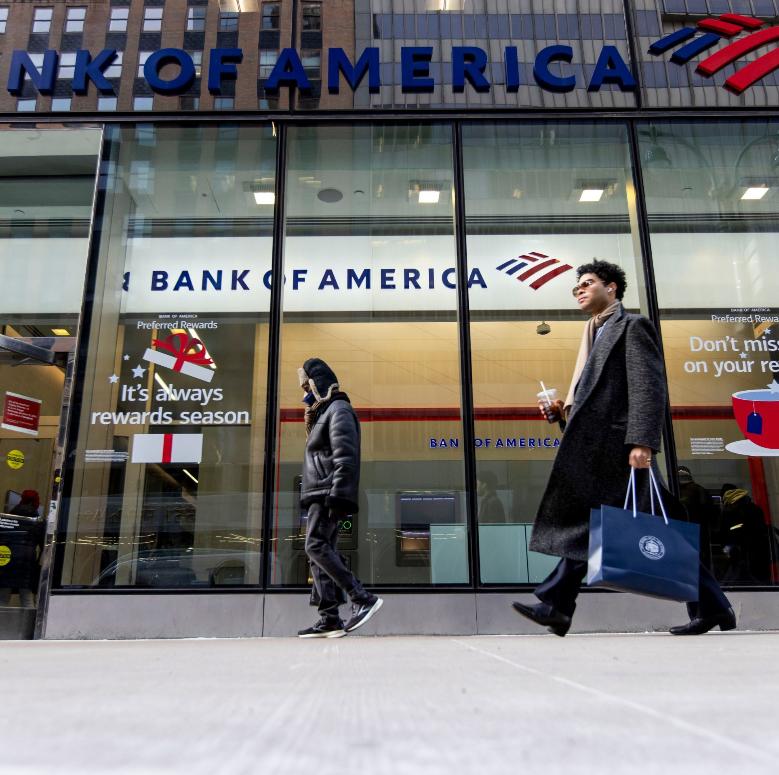
Setting
ARNATH
You are a risk analyst for Bank of Amarnath
Bank of Amarnath has minimal presence in your zip code
Should the bank offer more home loans in your zip code?

